Slide 1

Presentation on IPv4
Addressing & Subnetting
Submitted by: Shaid Ibna Sobhan

Slide 2
Introduction
Overview of IPv4 Addressing and Subnetting

Slide 3
What is IPv4?
Understanding IPv4 Addressing and Its Significance
IPv4, or Internet Protocol version 4, is essential for defining network addresses and facilitating communication across the internet, with approximately 4.3 billion unique addresses available for devices.

Slide 4
Relevance
Significance for Networking and Studies
Understanding IPv4 addressing and subnetting is crucial for networking proficiency, enhancing academic knowledge and preparing students for practical applications in the technology industry.

Slide 5
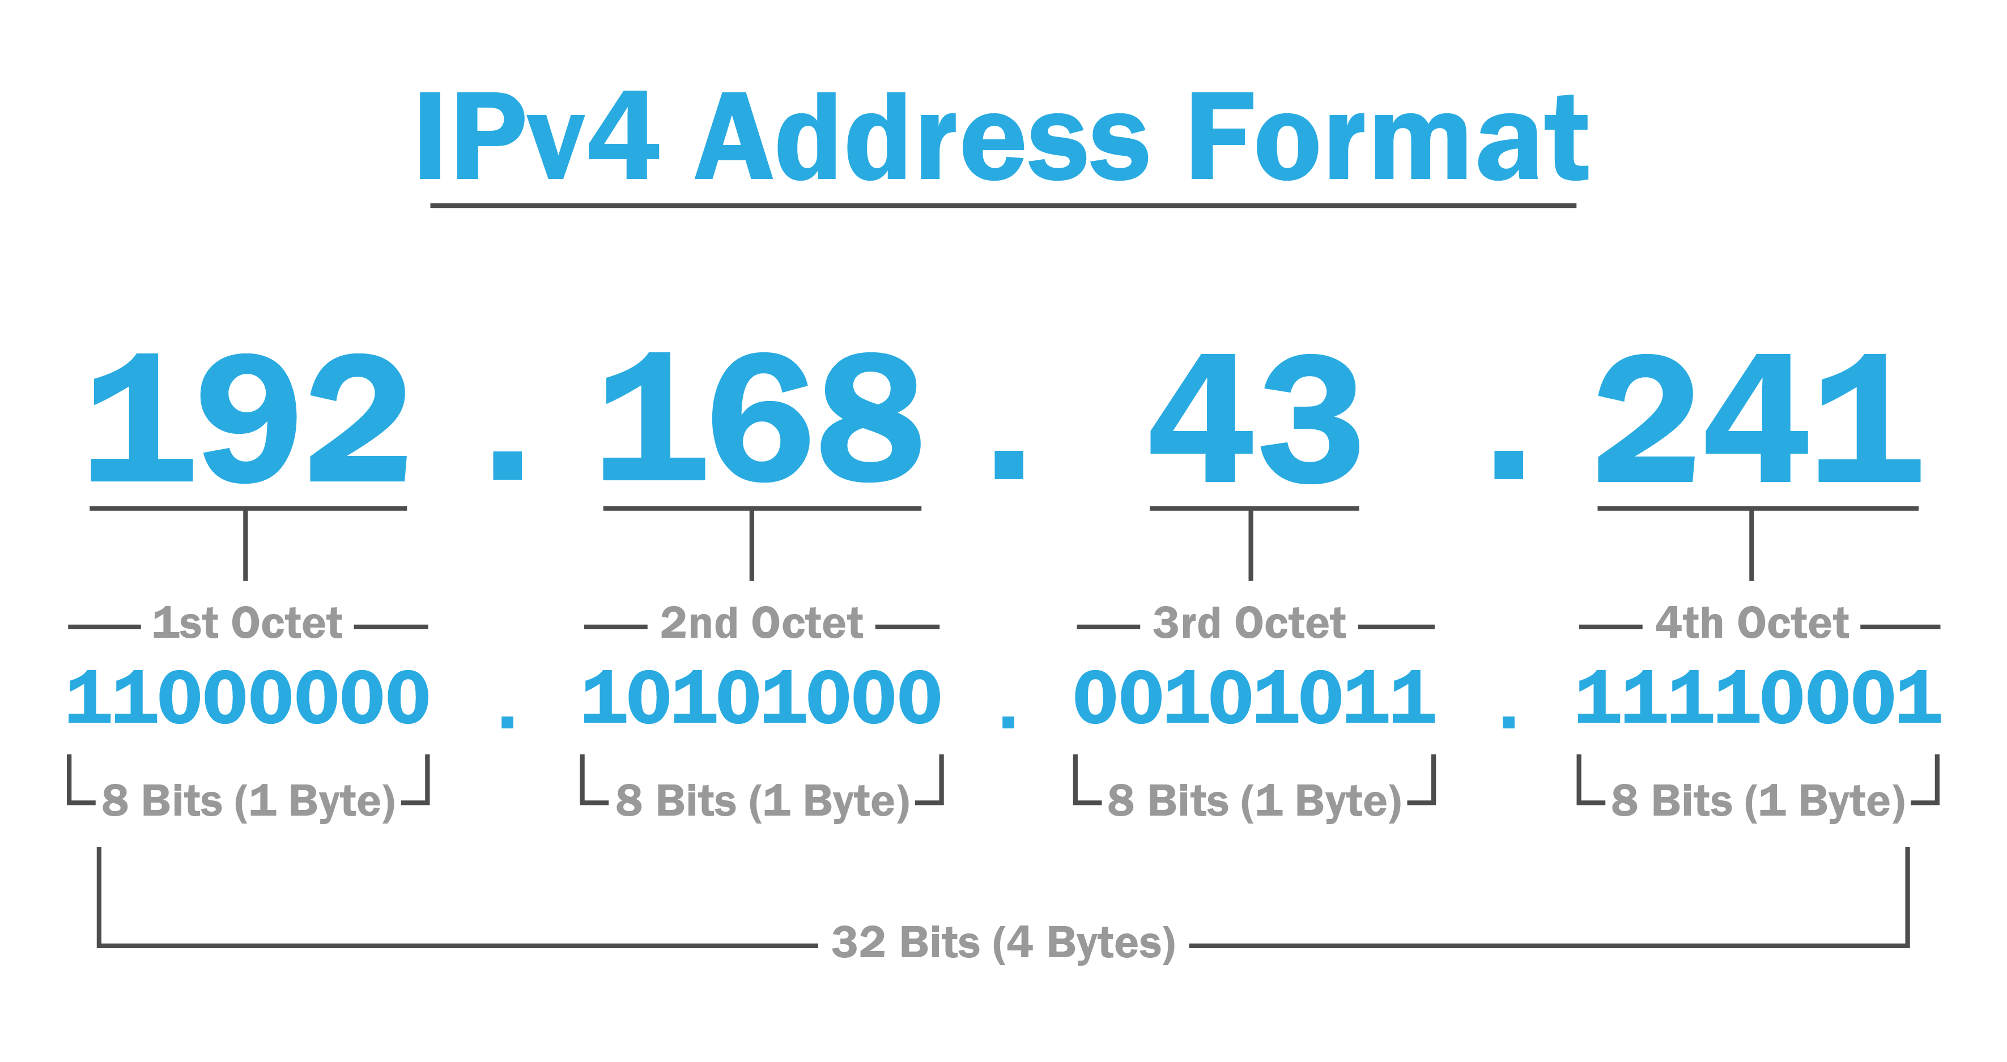
IPv4 Address Structure

Slide 6
IPv4 Address Structure
Understanding the 32-bit addressing scheme
32-bit Structure
Network ID
Host ID
An IPv4 address consists of 32 bits divided into four octets. Each octet is represented in decimal format, typically ranging from 0 to 255.
The Network ID identifies the specific network segment. It is crucial for routing packets across the internet and differentiates various networks from each other.
The Host ID portion specifies individual devices within the network. This allows for multiple hosts to be identified on the same network using unique identifiers.

Slide 7
IPv4 Address Classes
Understanding Different IP Classifications
Class A
Class B
Class C
Class A addresses range from 1.0.0.0 to 126.0.0.0, allowing for a large number of hosts, typically used for very large networks.
Class B addresses range from 128.0.0.0 to 191.255.0.0, suitable for medium to large networks, supporting up to 65,534 hosts in each class B network.
Class C addresses range from 192.0.0.0 to 223.255.255.0, ideal for small networks, allowing up to 254 hosts in each class C network.

Slide 8
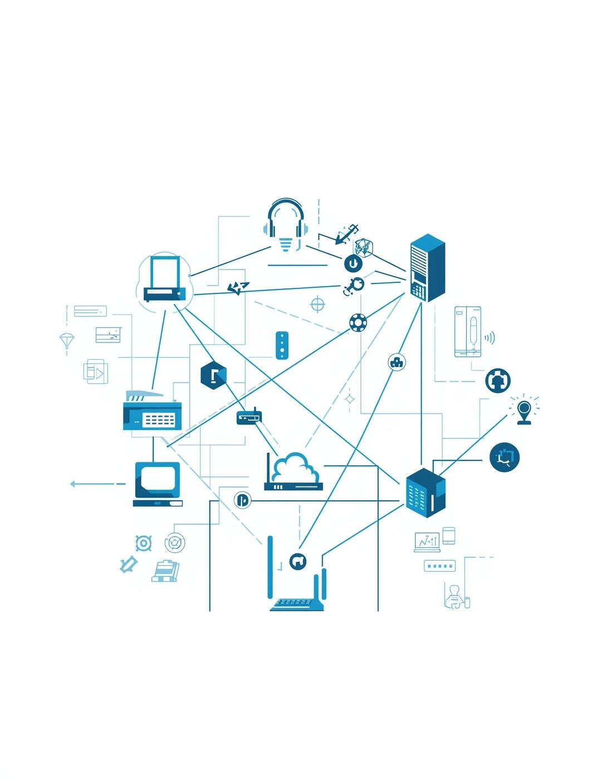
Class D & E IPs
Class D addresses are used for multicast, while Class E is reserved for experimental purposes and research.

Slide 9

Subnetting Concepts Explained
01
Defining Subnetting
Subnetting is the process of dividing networks efficiently.
02
Reasons for Subnetting
Subnetting helps improve network performance and security measures.
03
Efficient IP Usage
It maximizes IP address utilization within a network infrastructure.

Slide 10
Subnet Masks Overview
01
Binary Format
Subnet masks are represented in binary form to separate bits.
02
Decimal Format
Subnet masks are also expressed in decimal notation for convenience.
03
Customized Masks
Customized subnet masks allow flexible network configurations tailored to needs.

Slide 11
CIDR Notation
Understanding Classless Inter-Domain Routing Concepts
CIDR notation simplifies IP allocation by expressing network prefixes using a slash followed by the number of significant bits, enhancing routing efficiency and scalability in networks.

Slide 12

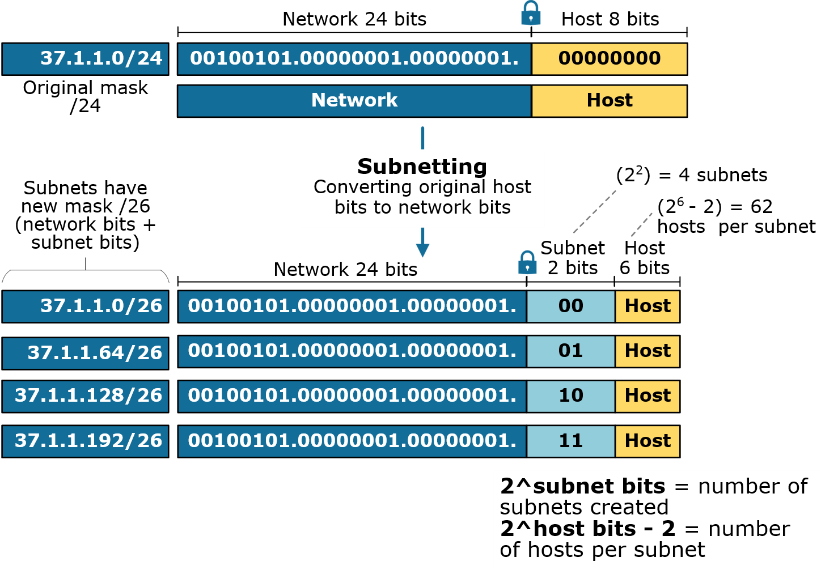
Subnetting Examples

Slide 13
Subnetting Example
Dividing a Class C Network into Subnets
Bits Borrowed
New Prefix Length
Subnet Address Ranges
To create four subnets from the 192.168.1.0/24 network, we borrow 2 bits from the host portion, allowing for efficient subnetting.
Borrowing 2 bits raises the subnet prefix from /24 to /26, resulting in four distinct subnets, each with 64 IP addresses available in total.
The subnet address ranges created are 192.168.1.0/26, 192.168.1.64/26, 192.168.1.128/26, and 192.168.1.192/26, supporting organized network management.

Slide 14
Host Calculations
The formula for calculating usable hosts is 2^host_bits - 2.
Usable Hosts
Subnet Ranges
Each subnet must account for network and broadcast addresses.
Subnet ranges help define addressable hosts in a subnet.
Understanding these concepts is crucial for effective subnetting.

Slide 15
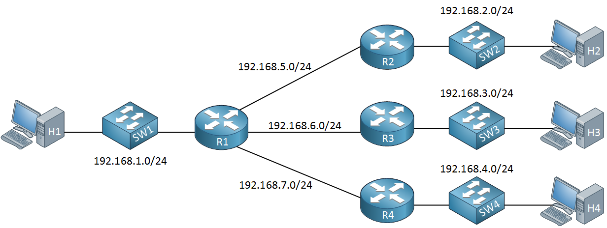
Network Diagrams
This diagram illustrates the division of subnets, showcasing how addressing and routing are efficiently managed in a network.

Slide 16
Advantages of Subnetting
Key Benefits of Subnetting
Improved IP address utilization
Reduced network congestion
Enhanced network security
Simplified troubleshooting processes

Slide 17
Advantages of Subnetting
Key Benefits of Subnetting
Facilitates logical device grouping
Enhances network performance and efficiency
Simplifies troubleshooting processes
Improves overall network security

Slide 18

Thank You

